Slide 1
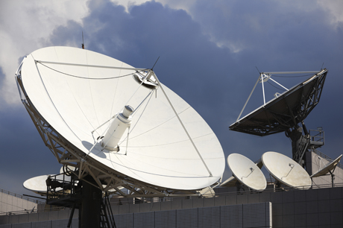
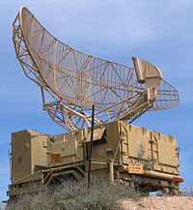

Radio Wave Propagation
Radio waves are a type of electromagnetic radiation with wavelengths in the Radio spectrum (3 kHz to 300GHz)
Broadcast
Radars
Navigation

Slide 2
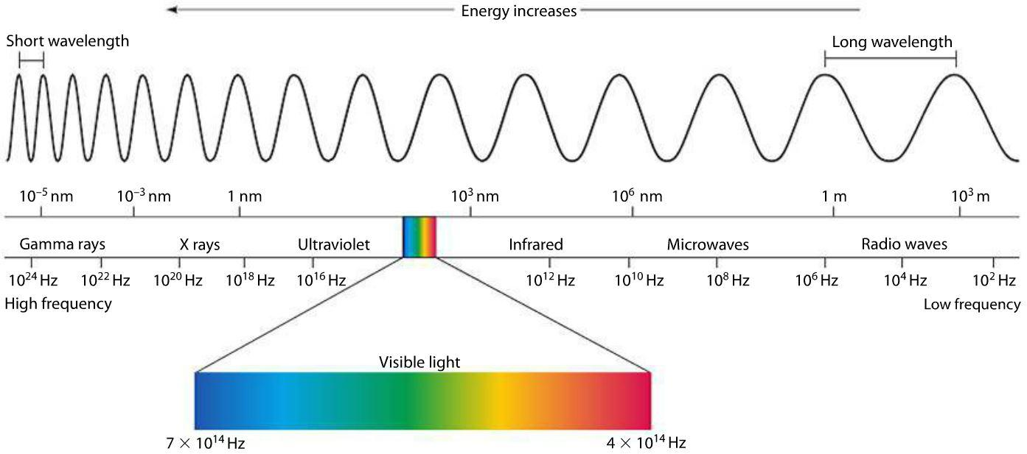
Electromagnetic Spectrum

Slide 3
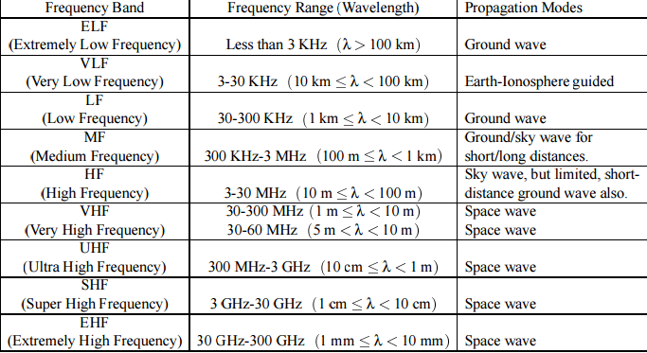
ITU(International Telecommunication Union) Radio Bands

Slide 4



Introduction- Mobile Radio Propagation Path
The Wireless Transmission Path may be
Radio Channels are random and time varying.
Line of Sight (LOS)
Non Line of Sight (NLOS)
Fresnel Zone
Fresnel Zone
Line of Sight
Line of Sight
Direct and unobstructed path between a transmitting device and a receiving or reflecting device. Microwaves are propagated in this manner and repeaters can be utilized to extend their range.
communication path is obstructed by buildings, foliage, hills etc.

Slide 5
Basics of Propagation
When electrons moves they create electromagnetic waves that can propagate through space.
By attaching an antenna of appropriate size to an electrical circuit, the electromagnetic waves can be broadcast efficiently and received by receiver some distance away.
Information can be sent by modulating the Amplitude, Frequency or phase of the waves.

Slide 6
Properties of Radio waves
Easy to generate.
- When electrons moves they create electromagnetic waves that can propagate through space. By attaching an antenna of appropriate size to an electrical circuit, the electromagnetic waves can be broadcast efficiently and received by receiver some distance away
Can travel Long distances.
Can penetrate buildings.
Used for both indoor and Outdoor Communications.
They are omni directional
Can be narrowly focused at high frequency(greater than 100MHz) using parabolic antennas.

Slide 7
Properties of Radio waves
Frequency dependence
- radio waves behave more like light at higher frequencies. Difficult in Passing obstacles. Absorbed by Rain.
- At lower frequencies ,it can pass obstacles but the power falls sharply with distance from Source.
Subject to interference from other Radio wave sources.

Slide 8
Summary
Radio waves are electromagnetic radiation in the frequency range (3KHz to 300KHz)
Radio waves are used in Broadcast, Navigation, cellular systems, Radars etc.
ITU has divided the radio spectrum into various frequency bands to avoid interference and effective use of radio spectrum.
Radio waves generation is easy, it can penetrate buildings, travel long distances etc.

